Slide 1
DECORATORS AND GENERATORS IN PYTHON
Presented By Bandari Karunasri

Slide 2
DECORATORS

Slide 3
What is a Decorators?
A Decorator is a special type of function in python that can be used to modify or enhance the behavior of other functions or methods.
For adding the new functionality to the existing function you need to pass that function as an argument is decorator function and call it inside inner function of decorator.
A function can be decorated by using the @ symbol along with the name of the decorator function and placing it above that function definition which you want to decorate.

Slide 4
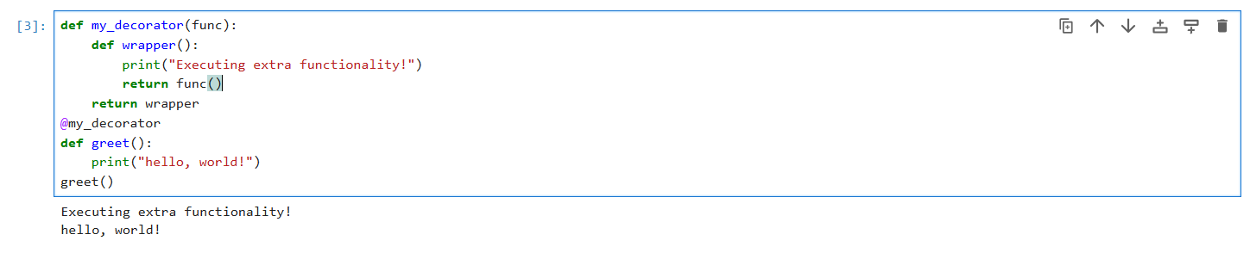
Example of a Simple Decorator

Slide 5
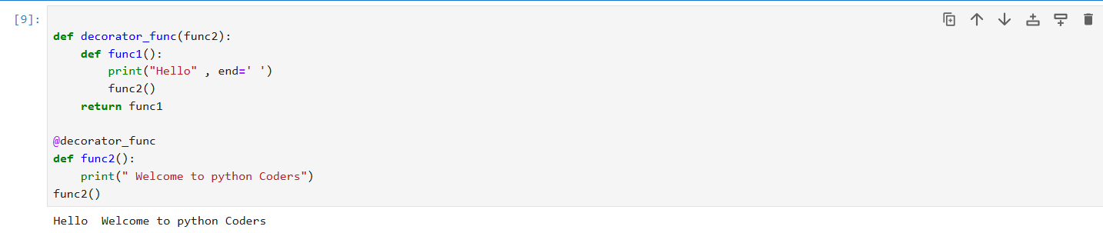
Example

Slide 6
Why Use Decorators?
Decorators are useful because they allow you to add functionality to existing functions in a clean and reusable way , without changing the original function code.

Slide 7
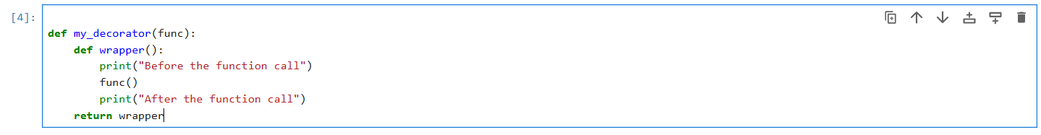
How Do Decorators Work?
Define a Decorator function: This function takes another function as an argument and returns a new function that adds some behaviour to the original function.
Example:

Slide 8
Apply the Decorator: Use the @decorator_name syntax above the function you want to enhance. The @ syntax is shorthand for passing the function into the decorator.
Example:

Slide 9
Types of Decorators
Decorator Type | Purpose | Example Use Case
Function Decorators | Modify behaviour of function | Logging, Authentication, performance tracking
Class Decorators | Modify behaviour of classes | Singleton pattern, Object creation control.
Built In Decorators | Predefined decorators in python | @Static method @class method @property

Slide 10
Built-In Python Decorators
@Static method: Defines a static method in a class.
@class method: Defines a class method inside a class.
@property: Allows a method to be accessed as an attribute.

Slide 11
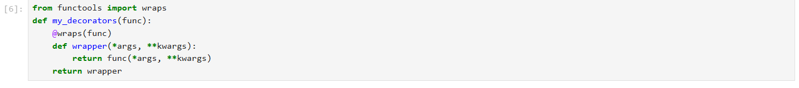
Function Wrapping and functools.wraps
When using decorators, the original function’s metadata(name, docstring etc.) may be lost. Use functools.wraps to preserve the original functions properties.

Slide 12
Daily Activities & Their Decorators
Here’s a table with daily activities, their use cases
Activity | Decorator Name | Decorator Use Case
Wake Up | @wakeup_reminder | Alerts you to wake up
Drink Water | @water_reminder | Encourages hydration
Workout | @workout_timer | Tracks workout duration
Cooking | @cooking_timer | Measures cooking time
Groceries | @groceries_reminder | Prevents forgetting items
Sleeping | @sleep_tracker | Tracks sleep duration

Slide 13
How each Decorator works
@wakeup_reminder: Prints a wakeup alert before running the function.
@water_reminder: Reminds you to drink water before continuing.
@workout_timer: Tracks how long a workout takes.
@cooking_timer: Logs cooking duration for efficiency.
@groceries_reminder: Ensures you check your groceries list before leaving.
@sleep_tracker: Tracks and logs sleep time.

Slide 14
1. Wake Up Reminder Decorator
wakeup_remainder: wakeup alert(morning routine notification). This decorator ensures you don’t forget to wake up on time.
Program:
import time
def wakeup_reminder(func):
def wrapper(*args, **kwargs):
print(“Reminder: It’s time to wake up!”)
return func(*args, **kwargs)
return wrapper
@wakeup_reminder
def morning_routine(name):
print(f “Good morning, {name}! Time to start your day.”)
Name = input(“Enter your name:”)
Morning_routine(name)

Slide 15
Input:
Output:

Slide 16
2.Water Drinking Remainder Decorator
water_remainder: hydration alert(Drinking enough water daily).Reminds you to drink at regular intervals.
Program:
import time
def water_reminder(func):
def wrapper(*args, **kwargs):
print(“Reminder: Drink a glass of water!”)
return func(*args, **kwargs)
return wrapper
@water_reminder
def drink_water(name):
print(f “{name}, you just drank water! Stay hydrated!”)
name = input(“Enter your name:”)
drink_water(name)

Slide 17
Input:
Output:

Slide 18
3.Work Out Timer Decorator
workout_timer:Tracks workout time(fitness and exercise tracking) Tracks how long a workout takes.
Program:
import time
def workout_timer(func):
def wrapper(*args, **kwargs):
start_time = time.time()
result = func(*args, **kwargs)
end_time = time.time()
print(f"Workout duration: {end_time - start_time:.2f} hour")
return result
return wrapper
@workout_timer
def exercise(exercise_name, duration):
print(f"Doing {exercise_name} for {duration} hour...")
time.sleep(duration)
print(f"{exercise_name} completed!")
exercise_name = input("Enter exercise name: ")
duration = int(input("Enter duration (hour): "))
exercise(exercise_name, duration)

Slide 19

Input:
Output:

Slide 20
4.Cooking Timer Decorator
cooking_timer: Measures cooking time(ensuring food is cooked properly).Helps you track cooking time for a dish.
Program:
import time
def cooking_timer(func):
def wrapper(*args, **kwargs):
start = time.time()
result = func(*args, **kwargs)
end = time.time()
print(f"Cooking time: {end - start:.2f} hour")
return result
return wrapper
@cooking_timer
def cook_dish(dish_name, duration):
print(f"Cooking {dish_name} for {duration} hour...")
time.sleep(duration)
print(f"{dish_name} is ready!")
dish_name = input("Enter dish name: ")
duration = int(input("Enter cooking time (hour): "))
cook_dish(dish_name, duration)

Slide 21

Input:
Output:

Slide 22
5.Groceries reminder Decorator
groceries_remainder:Prevents forgetting items(groceries checklist). Ensures you check your groceries list before leaving.
Program:
def grocery_reminder(func):
def wrapper(*args, **kwargs):
print("Reminder: Check your grocries list before leaving!")
return func(*args, **kwargs)
return wrapper
@grocery_reminder
def grocery_list(items):
print("Groceries list:", ", ".join(items))
print("Thank you visit again....")
items = input("Enter grocery items (comma-separated): ").split(",")
grocery_list(items)

Slide 23

Input:
Output:

Slide 24
6.Sleep Tracker Decorator
sleep_tracker: Measures sleep time(ensuring proper rest).Tracks and logs sleep time.
Program:
import time
def sleep_tracker(func):
def wrapper(*args, **kwargs):
print("Tracking your sleep... ")
result = func(*args, **kwargs)
print("Hope you had a good rest!")
return result
return wrapper
@sleep_tracker
def sleep(duration):
print(f"Sleeping for {duration} hours...")
time.sleep(duration)
duration = int(input("Enter sleep duration maxmium (hours): "))
sleep(duration)

Slide 25

Input:
Output:

Slide 26
Summary about Decorators
Decorators are powerful tools in python for modifying function behavior.
They help improve code modularity, readability, and reuse.
Python provides built-in decorators like static method, class method and property.
Always remember to preserve function metadata with functools.wraps when creating custom decorators.

Slide 27
Summary of Benefits
Automates Daily Routine – Ensures essential tasks are completed.
Tracks Time Efficiency – Logs workout, cooking, and sleep duration.
Improves Productivity – Reduces forgetfulness and keeps you on schedule.
Reusable & Scalable – Can easily add more daily activities.
Ideal for people with busy schedules to stay organized.
Encourages healthy habits like hydration, exercise, and proper sleep.
Supports improved time tracking for activities like cooking and workouts.

Slide 28
GENERATORS

Slide 29
What is a Generator?
Generator function are a special kind of function that returns a Lazy Iterator

Slide 30
Why Use Generators?
Memory Efficiency: Since generators yield items one at a time, they don’t store the entire sequence in memory.
Lazy Evaluation: They compute values on the fly, making them ideal for handling large data streams.
Improved Performance: Reduces memory overhead by avoiding creating and storing large data structures.

Slide 31
Creating a Generator
Syntax: A Generator is created using a function with the yield keyword instead of return.
Yield allows the function to return a value, but the functions state is remembered between calls.
When the generator is called, it returns a generator object.

Slide 32
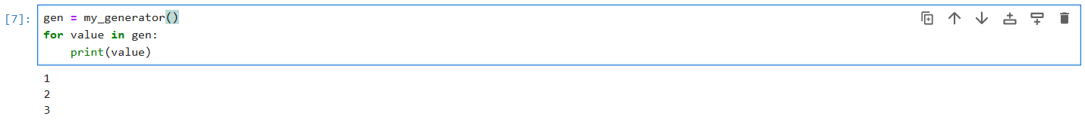
Using a Generator
How to get values from a generator.
You can loop over the generator using a ‘for’ loop or use the ‘next()’ function to get individual items.
With next() method.

Slide 33
Generators vs Iterators
Iterators: Any object that implements the _iter()_ and _next()_ methods.
Generators: A type of iterators, but they are created automatically using functions with ‘yield’.
Though Generators are a subclass of Iterators, they are more handy and compact. Iterators, which require _iter_ and _next()_ methods, Generators are simple functions with a yield statement.
Feature | Generator | Iterator
Memory Usage | Efficient(Lazy evaluation) | Less Efficient
Creation | Using yield in a function | Requires separate class
State Management | Automatically handles state | Must manage manually

Slide 34
Cont..
When an iterator object is created and you loop over, every time _next_ hook is called to generate a new value. This makes instance to store the value in member variables until next iteration.
When generator function is called, it returns generator iterator or generator object, it also stores references to args in the function state.
Now, when these generator objects are looped over, function is executed till yield keyword, value is returned, state of the function including instruction pointer, locals and other parameters are saved until resumed. When they are iterated over again, state is restored. This is much more performance as compared to a calling a function / call back on every iteration.

Slide 35
Benefits:
Generators are easy and compact to implement and use.
Reduces overhead of multiple function calls (no __next__ and __iter__ hooks).
Raises any exception like normal function and get exhausted.
Can be thrown custom exceptions to exhaust them (throw method), not supported in iterators.
Can be used a coroutines and consume values from user.

Slide 36
Magical yield Keyword
yield is a special keyword in python which turns a normal function into a generator. yield is also responsible for generating new value, returning the generated value, and suspending the execution until the next iteration.
yield is like return in python, except that it also saves the state of the function, suspends its execution, and resumes it when called upon.
yield can also consume values using send() method on generator object.

Slide 37
Initalizing a generator
When we call a generator function, it returns a generator object that can be stored in a variable.
When we call next() on this generator object, it initializes generator object, execution starts and suspends till it reaches the yield keyword.
Note: we will need to initialize the generator object by calling the next method before we can use the send(), throw() and close() methods.
send() method: Used to send values into a generator.
close() method: Used to close the generator when it’s no longer needed.
throw() method: Allows you to raise an exception inside a generator.

Slide 38
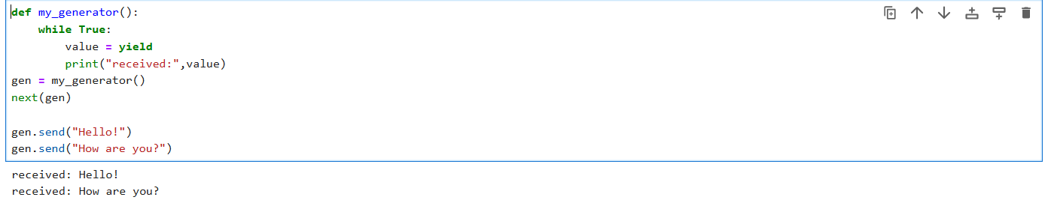
Example of send() method

Slide 39
Facts about Generators
Generators also get exhausted like an iterator object and raise the StopIteration Exception. When looped over, this exeception is automatically handled by construct.
Generator objects can only be used once i.e. they cannot be reused once exhausted.
Note: StopIteration is a natural exception that’s raised to signal the end of an iterator.

Slide 40
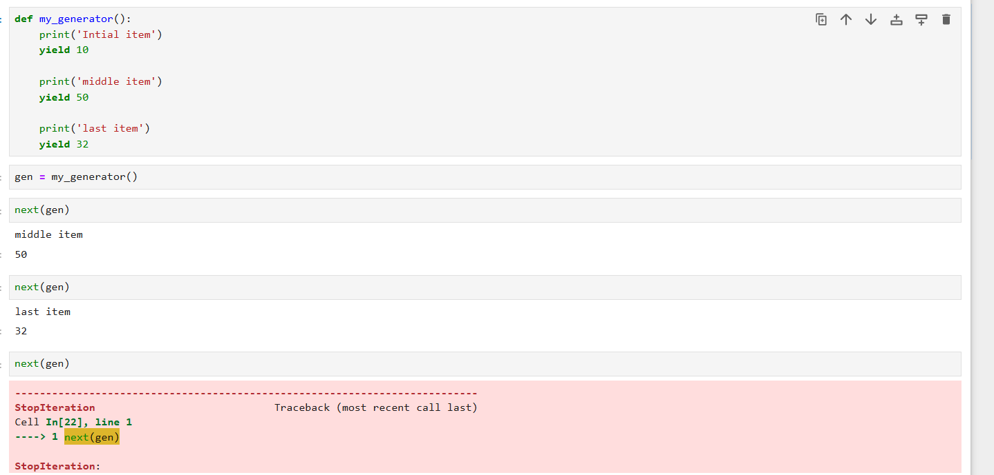
StopIteration Example

Slide 41
Real Time Activities & their Generators
Here’s a table with Real time activities and their Use Cases.
S.No | Activity | Generator Use Case
1. | Fibonacci Series | A Generator that produces Fibonacci numbers.
2. | Movie Ticket Booking | A Generator that assigns seat numbers to customers.
3. | Traffic Light System | A Generator that Continuously cycles through traffic lights.
4. | ATM Cash Dispenses | A Generator that dispenses cash in 100’s, 500’s and 2000’s.

Slide 42
1.Generating Fibonacci Series.
Program:
def fibonacci_series():
a, b = 0, 1
while True:
yield a
a, b = b, a + b
n = int(input("Enter number of Fibonacci numbers: "))
fib_gen = fibonacci_series()
print("Fibonacci Series:")
for _ in range(n):
print(next(fib_gen), end=" ")

Slide 43

Input:
Output:

Slide 44
2.Movie Ticket Booking
Program:
def seat_number_generator(row='A', seats=10):
for i in range(1, seats + 1):
yield f”Seat {row}{i}”
row_letter = input("Enter row letter: ")
num_seats = int(input("Enter number of seats: "))
seats = seat_number_generator(row_letter, num_seats)
for _ in range(num_seats):
print(next(seats))

Slide 45

Input:
Output:

Slide 46
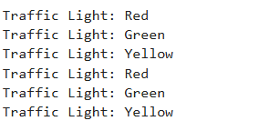
3.Traffic Light System
Program:
import time
def traffic_light():
lights = [("Red", 5), ("Green", 4), ("Yellow", 2)]
while True:
for light, duration in lights:
yield light
time.sleep(duration)
light_cycle = traffic_light()
for _ in range(6):
print("Traffic Light:", next(light_cycle))
Output:

Slide 47
4.ATM Cash Dispenses
Program:
def atm_cash_dispenser(amount):
denominations = [2000, 500, 200, 100, 50, 20, 10]
for note in denominations:
count = amount // note
if count:
yield f"{count} x ₹{note}"
amount %= note
if amount > 0:
yield "Remaining amount cannot be dispensed.“
withdrawal_amount = int(input("Enter amount to withdraw: "))
print("Cash Dispensal:")
for cash in atm_cash_dispenser(withdrawal_amount):
print(cash)

Slide 48
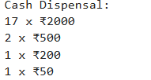
Testcase1:
Input:
Output:

Slide 49
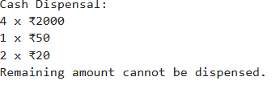
Testcase2:
Input:
Output:

Slide 50
Summary about Generators
Generators are a great way to handle large datasets efficiently and improve performance in python.
Key Takeaways: They are memory-efficient, created with yield, and support lazy evaluation.
Use Cases: Reading large files, processing data streams, and infinite sequences.

